Slide 1
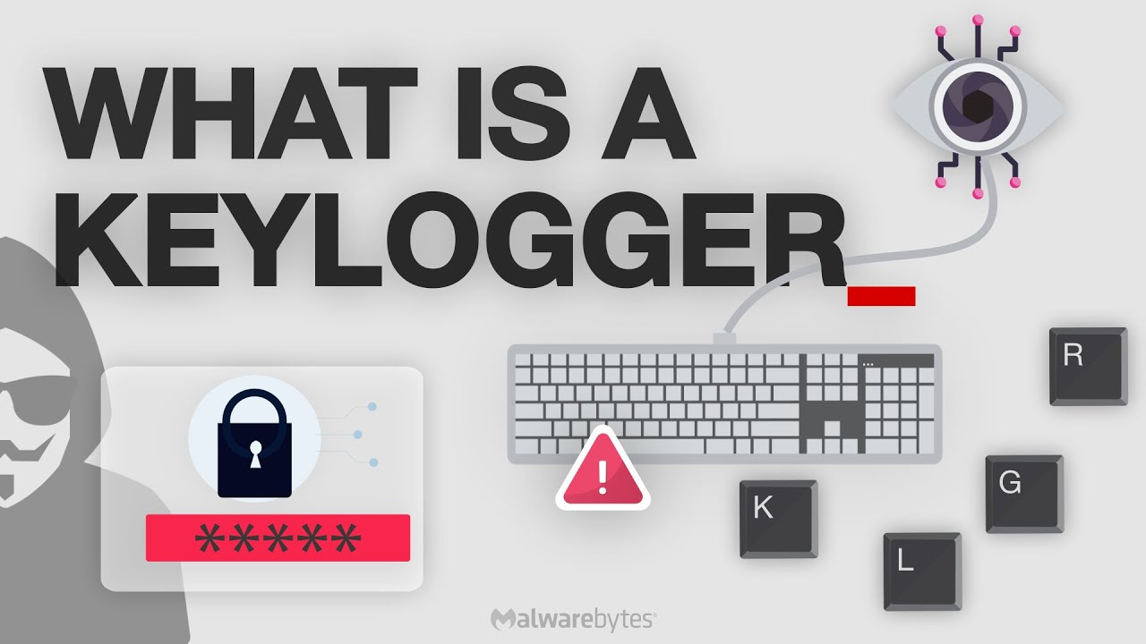
Keyloggers project

Slide 2
Present by,
S.M. Prabha,
3rd year computer science and engineering,
Universal college of engineering and technology.

Slide 3
A keylogger or keystroke logger/keyboard capturing is a form of malware or hardware that keeps track of and records your keystrokes as you type. It takes the information and sends it to a hacker using a command-and-control (C&C) server.
Keyloggers:

Slide 4
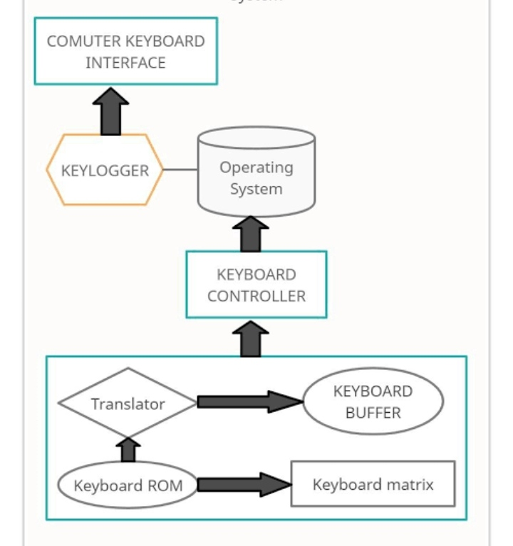
Keyloggers Architecture:

Slide 5
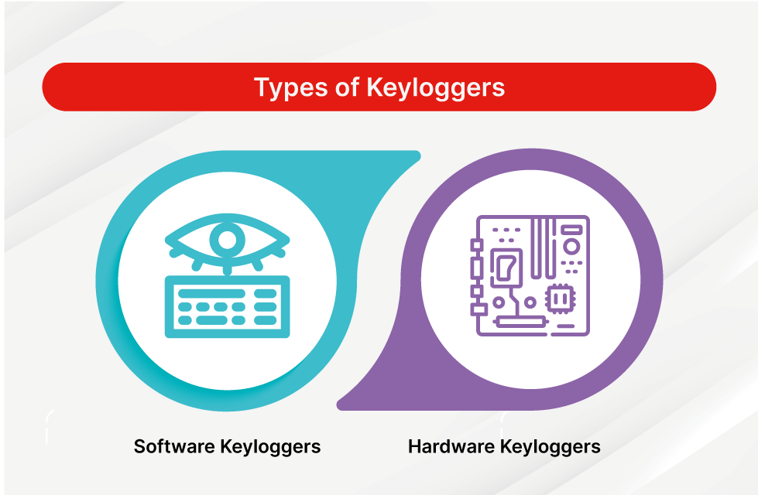
Types of keyloggers:
There are two types in keyloggers,
Hardware
Software

Slide 6
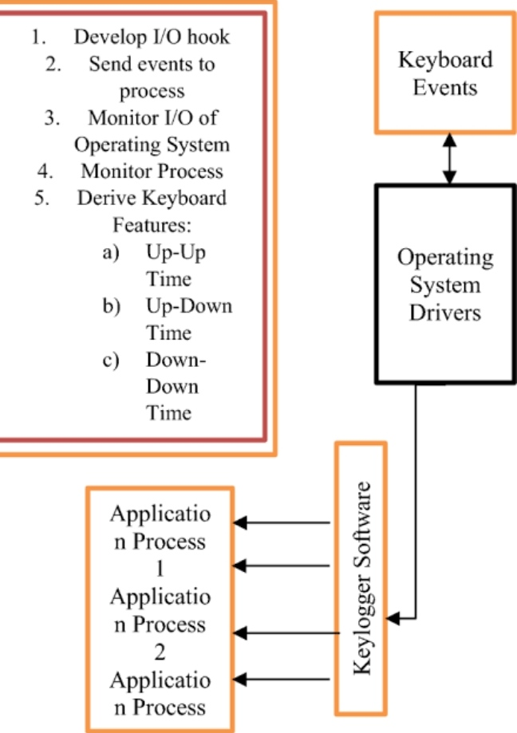
Software:
EyeZy is another remote monitoring software suite with great keylogging features alongside a full mobile phone data sync capability.
Each keystroke on the target device is captured, even if it's typed into a secure field like a password field.

Slide 7
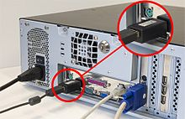
Hardware:
Hardware keyloggers are used for keystroke logging, a method of capturing and recording computer users' keystrokes, including sensitive passwords.

Slide 8
Conclusion:
Keyloggers are a potent threat to both individuals and enterprises, with the potential to cause significant harm if left undetected.

Slide 9
Thank you

